Slide 1
RESERVOIR COMPUTING IN DRAM
NAME : TANUJ KAUSHIK
ROLL NO. : 2021CSB073

Slide 2
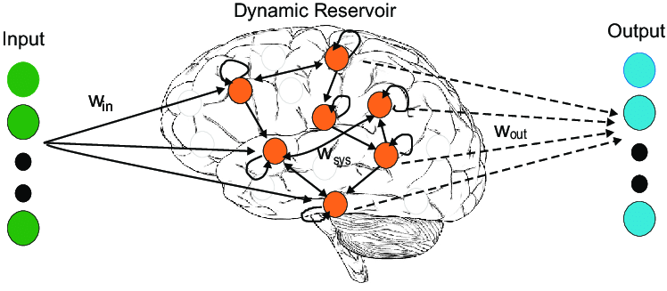
WHAT IS RESERVOIR COMPUTING ?
Reservoir computing is a framework for computation derived from recurrent neural network theory that maps input signals into higher dimensional computational spaces through a fixed, non-linear system called a reservoir.
Used for processing sequential data, such as time series data or sequences of symbols.
It belongs to the broader category of recurrent neural networks (RNNs).
A recurrent neural network (RNN) is a deep learning
model that is trained to process and convert a sequential
data input into a specific sequential data output.
Sequential data is data—such as words, sentences, or
time-series data—where sequential components
interrelate based on complex semantics and syntax rules.

Slide 3
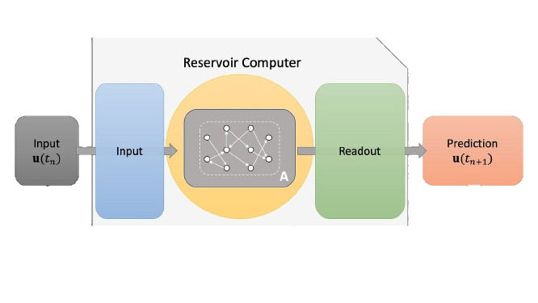
HOW RESERVOIR COMPUTING WORKS:
SEQUENTIAL DATA
DATA PASSED TO HIGH DIMENSIONAL SPACE
PASSED TO RESERVOIR
OUTPUT DATA GENERATED
DATA TRAINED USING SUPERVISED LEARNING TECH.
TO KNOW THE FULL WORKING : CIMA\Working of Reservoir Computing.txt

Slide 4

What distinguishes reservoir computing from traditional RNNs ?
Its unique architecture, which consists of a fixed and randomly generated network called the "reservoir," combined with a trainable output layer.
____________________________________________________________________________________________
RESERVOIR
Acts as a dynamic memory to store and process temporal information.
Large, randomly connected network
of neurons or nodes.
Not trained; connections are fixed
and randomly generated.
Popular variants of reservoir
computing include
Echo State Networks (ESNs) and
Liquid State Machines (LSMs).

Slide 5

Reservoir computing acts as a dynamic random access memory (D-RAM) in the context of processing sequential data by leveraging its reservoir dynamics.
Here's how reservoir computing can be likened to dynamic RAM:
Storage of Temporal Information: Reservoir holds temporal data temporarily.
Dynamic Memory Access: Reservoir accesses stored data dynamically.
Temporal Processing: Captures temporal patterns via random connectivity and non-linear functions.
Efficient Information Retrieval: Retrieves relevant data
efficiently for real-time processing.
Flexible and Adaptive: Adapts internal state based
on input data for versatile processing.
_____________________________________________
Usage: Time-series Prediction, Speech Recognition,
and Pattern Classification.
Graphics Double Data Rate 6 Synchronous Dynamic Random-Access Memory
designed for use in graphics cards, game consoles, and high-performance computing. Developed By Samsung.

Slide 6
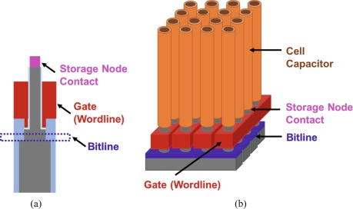
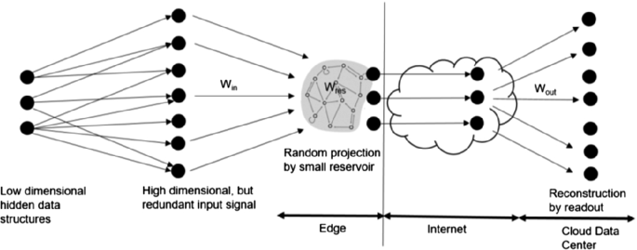
NOTE :
Reservoir computing does not function as DRAM.
DRAM is another type of volatile memory commonly used in computers for MM.
In DRAM, information needs to be periodically refreshed to maintain its integrity, while in reservoir computing, the dynamic nature of the reservoir captures temporal information from input sequences.
D-RAM STORAGE RC STORAGE

Slide 7

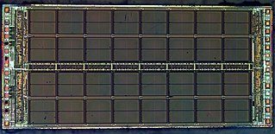
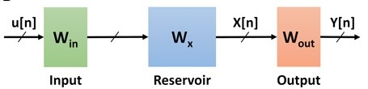
EXAMPLE: RESERVOIR COMPUTING FOR REAL-TIME PATTERN RECOGNITION
We have a system that needs to recognize patterns in a continuous stream of sensor data, such as identifying anomalies in a manufacturing process or detecting abnormal heart rhythms in medical monitoring.
RESERVOIR DRAM
OUTPUTS
INPUTS
DATA STORING & PROCESSING

Slide 8
Data Input: The continuous stream of sensor data is fed into the system.
Reservoir: A reservoir computing architecture is implemented in the system, where the DRAM serves as a storage unit for the reservoir states. The reservoir, consisting of randomly connected nodes, acts as a dynamic memory that captures temporal dependencies within the input data stream.
Processing: The reservoir processes the input data stream, capturing temporal patterns and extracting relevant features from the data.
Output Layer: The processed data from the reservoir is then passed through a trainable output layer, where it is used for pattern recognition tasks. The output layer may be trained using supervised learning techniques to classify patterns or anomalies in the data stream.
Real-Time Operation: Since DRAM provides fast access to stored data, the reservoir can efficiently access and update its internal states in real-time as new data arrives. This allows for timely processing of the continuous data stream and enables rapid pattern recognition.
Adaptability: The dynamic nature of reservoir computing allows the system to adapt to changes in the input data stream over time. As new patterns emerge or existing patterns evolve, the reservoir can dynamically adjust its internal state to maintain accuracy in pattern recognition.

Slide 9
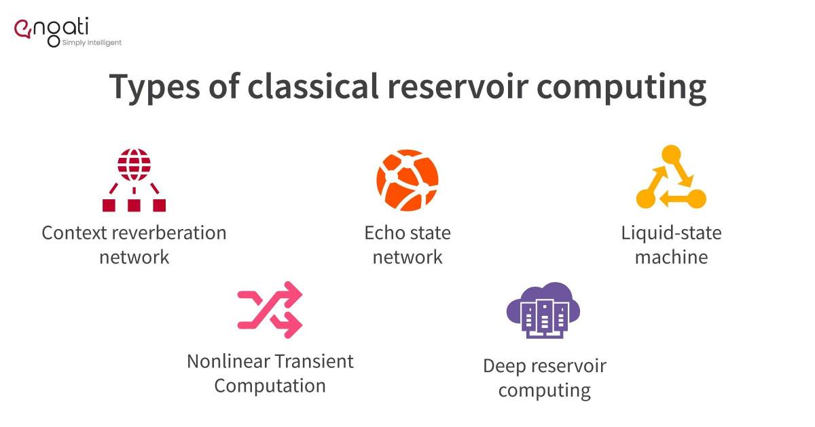
______________________________________________________________________________
In summary, while DRAM is a hardware component used for storing digital data in computing systems, RC is a machine learning technique used for processing sequential data. They serve different purposes and operate at different levels of abstraction within computing systems.

Slide 10
REFERENCES :
https://www.autoblocks.ai/glossary/reservoir-computing
https://en.wikipedia.org/wiki/Reservoir_computing
THANK YOU

